Slide 2
Introduction
Possible contagions make understanding network structure of financial interactions critical.
Need tools to help evaluate contagion risk.
Although large cascades are (today) off-path, it’s important to keep them off-path.

Slide 3
Growing Literature
Rochet, Tirole (1996)
Gai,Kapadia (2009)
Allen, Gale (2000)
Kiyotaki, Moore (1997)
Blume et al (2011ab)
Babus (2009)
Diebold, Yilmaz (2011)
Allen, Babus (2009)
Demange (2011)
Billio et al (2011)
Dette , Pauls, Rockmore (2011)
Eisenberg, Noe (2001)
Lorenza, Battiston, Schweitzer (2009)
Acemoglu, Carvalho, Ozdaglar, Tahbaz-Salehi (2012)
Cabrales, Gottardi, Vega-Redondo (2011)
Acemoglu, Ozdaglar, Tahbaz-Salehi (2013)
Cohen-Cole, Petacchini, Zenou (2012)
Gouriéroux, Héam, Monfort (2012)

Slide 4
Our Contributions
Develop model of cascades in a network of cross-holdings.
Distinguish the effects of diversification and integration.
Highlight nonmonotonic effects of diversification and integration on contagions.
Offer a simple illustration of how the model can be used empirically.

Slide 5
Outline
Model
Cascades: Diversification and Integration
An Illustration with European Debt Data
Cascades: Core/ Periphery

Slide 6
Basics of the Model
Organizations (countries, banks, firms, etc.) have claims on:
fundamental assets,
other organizations.
When an organization’s value falls below a critical level, the values of others’ claims on it drop – discontinously:
e.g., Greek tax receipts not enough to pay debt; creditors take >50% loss on value of their claims.
Drop in value of one organization leads to drop in values of others they have financial arrangements with – cascades.

Slide 7
Model
$\left\{1,…,n\right\}$: organizations (countries, firms, banks…)
$\left\{1,…,m\right\}$: assets (primitive investments)
$p_{k}$: price of asset k
$D_{ik}$: holding of asset k by organization i

Slide 8
Cross Holdings
$C_{ij}$: cross holdings: fraction of org. j held by org. i
$C_{ii}=0$: (don’t own yourself)
${\hat{C}}_{ii}=1−\sum_{j}{C_{ji}}$: fraction of org. i privately held

Slide 9
Value of an Organization
total value of all shares
$$V_{i}=\sum_{k}{D_{ik}p_{k}} + \sum_{j}{C_{ij}V_{j}}$$
direct asset holdings
cross-holdings

Slide 10
Example
Two organizations: $n=2$
Each owns half of the other:
Implied holdings by outside investors:
$$C=\left[\begin{matrix}0 & 0.5 \\ 0.5 & 0\end{matrix}\right]$$
$$\hat{C }=\left[\begin{matrix}0.5 & 0 \\ 0 & 0.5\end{matrix}\right]$$

Slide 11
Example
$$C_{21}=0.5$$
$${\hat{C}}_{11}=0.5$$
$${\hat{C}}_{22}=0.5$$
1
2
$$C_{12}=0.5$$

Slide 12
Value of an Organization
$$V_{i}=\sum_{k}{D_{ik}p_{k}} + \sum_{j}{C_{ij}V_{j}}$$
$$V=Dp+CV$$
Leontief calculation of value of all shares
$$V={\left(I−C\right)}^{−1} D p$$

Slide 13
Value of an Organization
Total value of all shares
$$V={\left(I−C\right)}^{−1} D p$$
Value to final (outside) investors.
$$v_{i}={\hat{C}}_{ii}V_{i}$$
$A_{ij}$ :
$$v=\hat{C }{\left(I−C\right)}^{−1} D p$$
fraction of the returns owned by org $j$that ultimately accrue to outside shareholders of $i$
$$A$$
$$v= D p$$
(cf. Brioschi et al. 89, Fedenia et al. 96)

Slide 14
Example
$$C_{21}=0.5$$
$${\hat{C}}_{11}=0.5$$
$${\hat{C}}_{22}=0.5$$
1
2
$$C_{12}=0.5$$

Slide 15
Example
What happens to $1 of investment income to 1?
.5
.5
.5
1
1
2
.5

Slide 16
Example
What happens to $1 of investment income to 1?
.5
.5
.5
.5
.5
1
1
2
.5

Slide 17
Example
What happens to $1 of investment income to 1?
.5
.5
.5
.5
.5
1
2
.5

Slide 18
Example
What happens to $1 of investment income to 1?
.5
.5
.5
.5
.5
.25
1
2
.25
.5

Slide 19
Example
What happens to $1 of investment income to 1?
.5
.5
.5
.5
.25
1
2
.25
.5

Slide 20
Example
What happens to $1 of investment income to 1?
.5
.5
.125
.5
.5
.25
1
2
.125
.25
.5

Slide 21
Example
What happens to $1 of investment income to 1?
.5
.5
.125
.5
.5
.25
1
2
.125
.5

Slide 22
Example
What happens to $1 of investment income to 1?
.5
.5
.125
.5
.5
.25
1
2
.125
.0625
.0625
.5

Slide 23
Example
What happens to $1 of investment income to 1?
.5
.5
.5
.5
.25
1
2
.125
.0625
.0625
.5

Slide 24
Example
What happens to $1 of investment income to 1?
.5
.5
.03125
.5
.5
.25
1
2
.125
.0625
.0625
.03125
.5

Slide 25
Example
What happens to $1 of investment income to 1?
.5
.5
.5
2/3
1/3
1
2
$$A=\left[\begin{matrix}2/3 & 1/3 \\ 1/3 & 2/3\end{matrix}\right]$$
.5

Slide 26
Discontinuous Losses
If an organization’s value drops below some threshold ${\underline{v}}_{i}$, its value falls by $β_{i}:$
$$b_{i}(v_{i})=\left\{\begin{aligned}β_{i} \text{if}{ v}_{i}<{\underline{v}}_{i} \\ \\ 0 \end{aligned}\right.$$
$$otherwise.$$
with failures:
$$v=A [Dp−b\left(v\right)]$$

Slide 27
Discontinuous Losses
full debt value
writedowns
Value of i’s debt
holding in j
$$0$$
Value of j

Slide 28
Discontinuous Losses
disorderly default
full debt value
writedowns
Value of i’s debt
holding in j
$$0$$
Value of j

Slide 29
Equilibria: Consistent Values
The equilibria form a complete lattice.
We focus on the unique “best-case” equilibrium where the fewest organizations fail.
Easy algorithm to find it:
Identify organizations that fail even if no others do (called a first failure).
Identify those that fail due to the failures identified above.
Iterate.
$$v=A [Dp−b\left(v\right)]$$

Slide 30
Foundations
Owner-operated firms that own shares of each other.
“Privately held” part accrues to owner.
Owner withdraws key capital if total value accruing is less than a threshold; loss in productivity.
$$v=A [Dp−b\left(v\right)]$$

Slide 31
Outline
Model
Cascades Diversification and Integration
Cascades: Core/ Periphery
An Illustration with European Debt Data

Slide 32
Three Necessary Components of a Cascade
A first failure: some organization must fail.
Local contagion: some other organization(s) must be sufficiently exposed to the failing org. to fail, too.
Wider propagation: for a cascade to continue, the network must have sufficiently large components.

Slide 33
What Affects Cascades
Diversification: How many other organizations does a typical organization hold?
Integration: How much of a typical organization is cross-held?

Slide 34
What Affects Cascades
Look at some simulations on random graphs
Some analytic results too

Slide 35
Simulation Setup
$n=100$ organizations
Simple random network G:
$Pr\left(G_{ij}=1\right)=d/(n−1)$
$d$= expected number of other organizations that an organization holds ($d=$ level of diversification)
Fraction of $c$ of an org. is evenly split among those holding it; $1−c$held outside ($c=$ level of integration)
So:
$$C_{ij}=\frac{c G_{ij}}{d_{j}}$$
$${\hat{C}}_{ii}=1−c$$

Slide 36
The Exercise
One asset per organization (their investments).
Each starts at value $p_{i}=1$;
Hence, value $v=A p=A 1$
Pick one asset to devalue to $0$.
Threshold is ${\underline{v}}_{i}=θv_{i}$ for all $i$; bankruptcy means lose all remaining value.
Look at resulting cascade.

Slide 37
Diversification and Contagion
θ = .93, c = .5
% of organizations failing
Degree: expected # of cross-holdings

Slide 38
Diversification and Contagion
% of organizations failing
.99
Various Thresholds
.96
θ = .93
.90
.87
Degree: expected # of cross-holdings

Slide 39
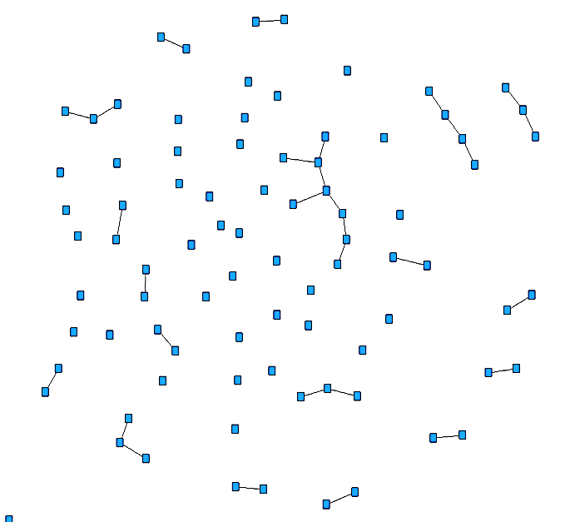
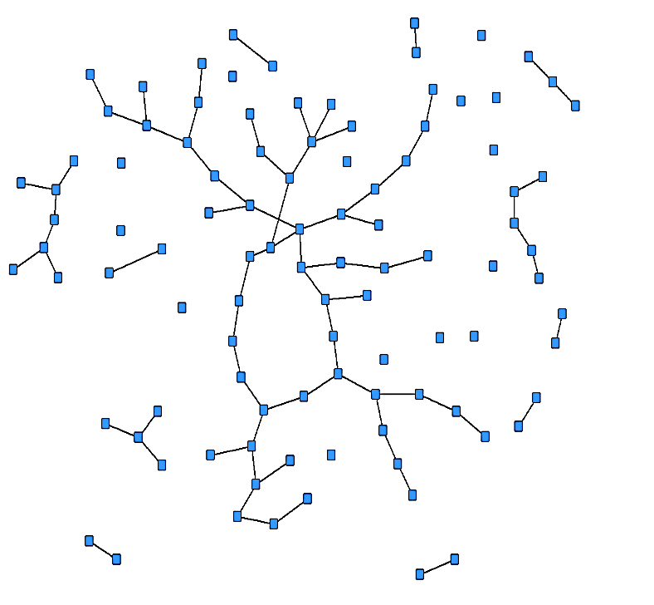
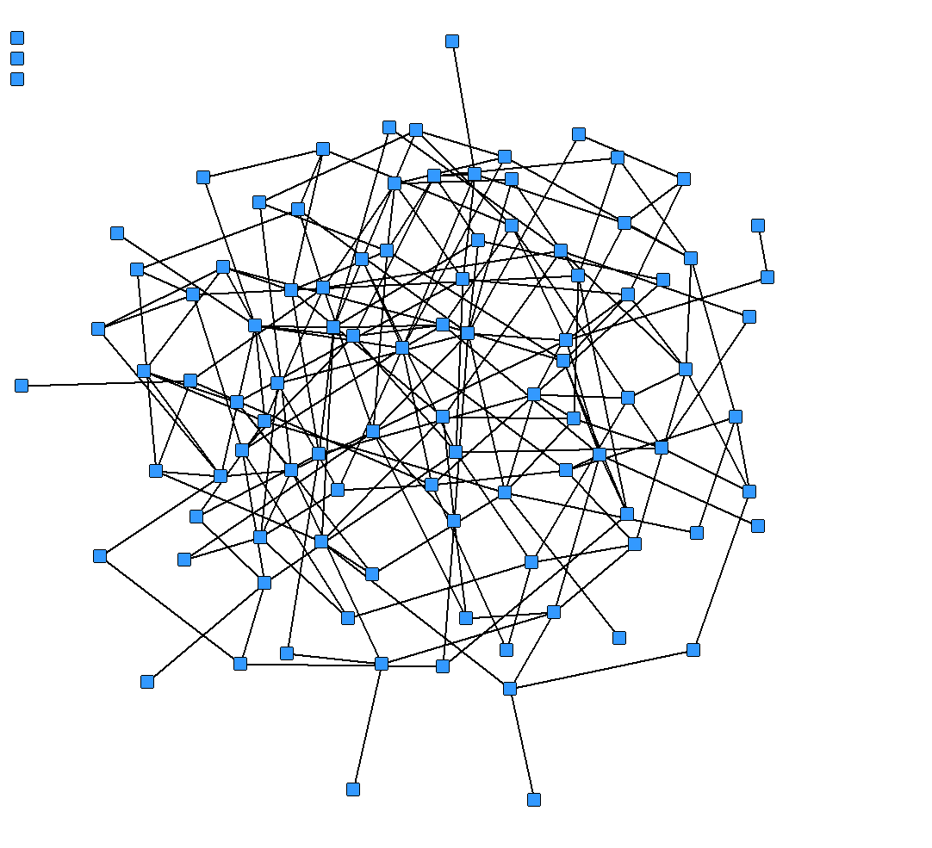
Diversification: Dangerous Middle Levels
$$d low$$
$$d middle$$
$$d high$$
Network not connected enough for large cascade
Connected network: wider propagation possible. And few counter-parties per org. enables local contagion.
Little exposure to any single other organization. Failures do not spread locally.

Slide 40
Integration
θ = .93, c = .5
% of organizations failing
.9
c = .5
.7
.3
.1
Degree: expected # of cross-holdings

Slide 41
Integration
Low integration: little exposure to others, failures don’t trigger others.
Middle integration: exposure to others substantial enough to trigger contagion.
High integration: difficult to get a first failure – failure of own assets does not trigger failure.

Slide 42
High Integration and First Failures
θ = .93
Frequency of first failures
c = .4
.6
. 7
.8
.9
Degree: Expected # of cross-holdings

Slide 43
Proposition: Diversification and Integration
Directed network with any distribution of in- and out- degrees:
“expectation” d (expected out-degree of the vertex at the end of a link chosen uniformly at random);
d_{min} and d_{max}: minimum and maximum degrees;
draw network uniformly at random;
common failure threshold $\underline{v}$;
integration level $c$;
initial asset values 1.

Slide 44
Proposition: Nonmonotonic Effects
v_{max}, v_{min} are highest, lowest realized initial values.
If integration is very low or high [ $c\left(1−c\right)<v_{min}−\underline{v}$ ] there is no limit contagion.
At middle integration levels, diversification matters. At
low degree [ $d<1$ ], no limit contagion.
medium degree $\left[1<d, d_{max}<\frac{c\left(1−c\right)}{v_{max}−\underline{v}}\right]$, get limit contagion.
high degree $\left[\frac{c(1−c)}{vmin−\underline{v}}<d_{min}\right]$, no limit contagion.

Slide 45
Summary via Cascades’ Three Ingredients
A first failure:
Some organization needs to fail
integration decreases own-asset dependence
Local contagion:
Some neighbors need to be sufficiently exposed to fail too
diversification decreases exposure of specific neighbors
integration increases exposure of neighbors
Wider propagation: for the many failures to happen, the network must have sufficiently large components
diversification increases component size

Slide 46
Outline
Model
Cascades Diversification and Integration
Cascades Core/ Periphery
An Illustration with European Debt Data
Cascades Diversification and Integration

Slide 47
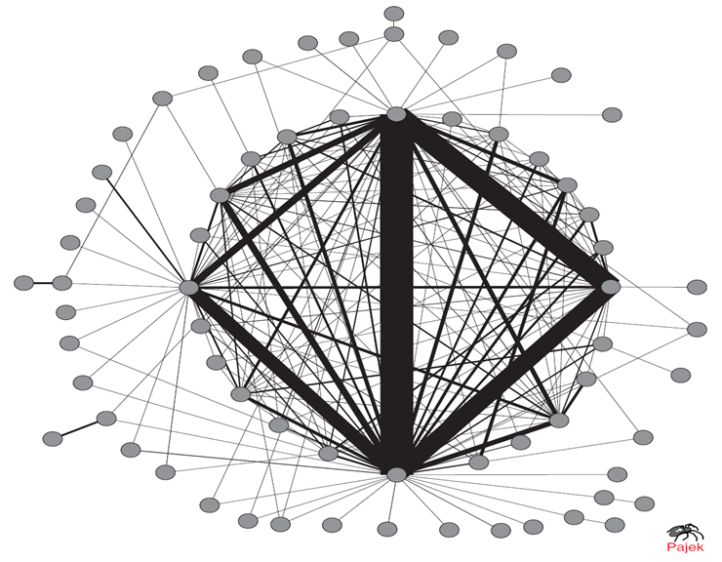
A Core-Periphery Network
2012 LARGEST BANKS IN ORDER:
JPMorgan Chase
Bank of America
Citigroup
Wells Fargo
Goldman Sachs
MetLife
Morgan Stanley
Soromaki et al
(2007)
Fedwire Interbank payments, nodes accounting for 75% of total; 25 nodes form clique (complete subgraph)

Slide 48
Outline
Model
Cascades Diversification and Integration
Cascades Core/Periphery
Illustration with European Debt Data

Slide 49
Illustrative Application
Consider 6 key countries in Europe that have substantial cross-holdings of each other’s debt.
Treat them as an isolated system (illustrating exercise, not for policy...).
See what happens if values fall (contraction) and debt is devalued.

Slide 50
Illustrative Application
Consider 6 key countries in Europe that have substantial cross-holdings of each other’s debt.
Treat them as an isolated system (illustrating exercise, not for policy...).
See what happens if values fall (contraction) and debt is devalued.

Slide 51
Raw Cross Holdings of Sovereign Debt
in Millions of $

Slide 52
Derived Exposures

Slide 53
Derived Exposures, Visually
Greece
.13
.12
.18
France
.13
Germany
.17
.12
.11
.07 ----
.11
.14
.07 --
.09
Spain
.05
Italy
.14
Portugal

Slide 54
Simulation Setup
Set ${\underline{v}}_{i}$ to be a fraction $θ$ of 2008 GDP.
Look at 2011 GDP as the asset $p_{i}$.
Calculate $v_{i}$.
Calculate cascades in best equilibrium.
Set ${β_{i}=\underline{v}}_{i}/2$ (could rescale everything to debt levels – here based on GDP levels)

Slide 55
Normalized GDPs
 | 2008 | 2011 | Drop %
France | 11.99 | 11.62 | 3
Germany | 15.28 | 14.88 | 3
Greece | 1.47 | 1.27 | 14
Italy | 9.65 | 9.20 | 5
Portugal | 1.06 | 1.00 | 6
Spain | 6.70 | 6.25 | 7

Slide 56
Cascades for Various Thresholds
θ fraction | .90 | .93 | .935 | .94
First Failure | Greece | Greece | Greece | Greece Portugal
Second Failure |  |  | Portugal | Spain
Third Failure |  |  | Spain | France
Fourth Failure |  |  | France Germany | Germany Italy
Fifth Failure |  |  | Italy

Slide 57
Story Behind Cascades
Portugal fragile: little exposure, but close to threshold.
Portugal triggers Spain, triggers France, Germany.
Italy is last to cascade: held by others, but much less exposed to Spain than France, Germany (but exposed to France, Greece).

Slide 58
Discussion, Next Steps
Diversification and integration both face (different) competing effects, nonmonotonicities.
Can be taken to data.
Model can serve as a foundation for studying bailouts and incentives.

